Slide 1
Pure Gloves
NITRILE DISPOSABLE GLOVE
  Manufacturer
  Shun Thai Rubber Gloves Industry Public Company Limited. is a leading manufacturer of latex and nitrile gloves for applications in both medical and general purpose markets. Our motto: "Highly Intend on Replying for your Satisfaction" translates and represents our core values and determination in providing our customers with an excellent quality products, along with the highest degree of customer service.
  Founded in 1989, Shun Thai commenced our operation by producing latex gloves for various medical fields. The factory is located in the Rayong province of eastern Thailand and has been and continues to be surrounded by thousands of acres of rubber tree plantations. With the advantage of having the natural latex materials in the vicinity and at hand, Shun Thai has built a reputation for greatness of quality in the gloves we produce.

Slide 2
Pure Gloves
NITRILE DISPOSABLE GLOVE
Presently, Shun Thai Rubber Gloves Industry Public Company Limited. Produces 75-90 million pieces per month of powder and powder free latex and powder free nitrile. Our core values represent the high degree of quality in the gloves we produce. Being in the middle of numerous rubber plantations and having an extensive amount of raw materials at our fingertips extends us an advantage in producing top quality products for which we have been known for.
Manufacturing operations are also accredited with ISO 9001:2008 and EN ISO 13485:2003 under CMDCAS. These qualifications ensures that we adhere to a strict quality management system that guarantees the highest quality of gloves are produced.

Slide 3
Pure Gloves
NITRILE DISPOSABLE GLOVE
Shun Thai Rubber Gloves Industry Public Company Limited. is committed to providing safe and effective products for healthcare providers and other users. This entails strict and stringent measures in manufacturing process and product quality control as well as a persistent attention to R&D efforts. The ultimate aim is to achieve complete customer satisfaction and ensure minimum risk in using the company's products.
Quality Management System
- ISO 9001:2008
- Certificate of good maunfacturing practices of medical device manufacture
- EC directive 93/42/EEC annex V CE mark on sterilised latex gloves and examination
- ISO 13485:2003 under CMDCAS

Slide 4
Pure Gloves
NITRILE DISPOSABLE GLOVE
Nitrile Examination Gloves : ASTM D 6319
1. Watertight test for holes ( ASTM D 5151 )
2. Dimensions ( ASTM D 3767 )
3. Physical Properties ( ASTM D 412 )
4. Powder Content ( ASTM D 6124 )
Nitrile Examination Gloves : EN 455-2
1. Watertight test for holes ( EN 445-1 )
2. Dimensions ( EN 445-2 )
3. Physical Properties ( EN 455-2 )
4. Powder Content ( ASTM D 6124 )
FDA 510K certification
- FDA 510K registration
- With us FDA on powder-free nitrite examination gloves and chemotherapy gloves

Slide 5
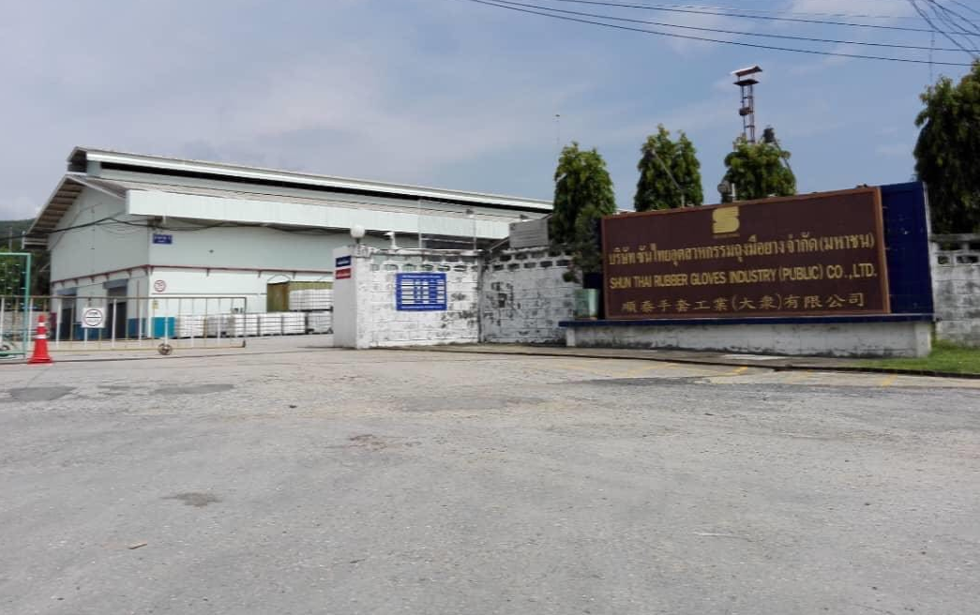
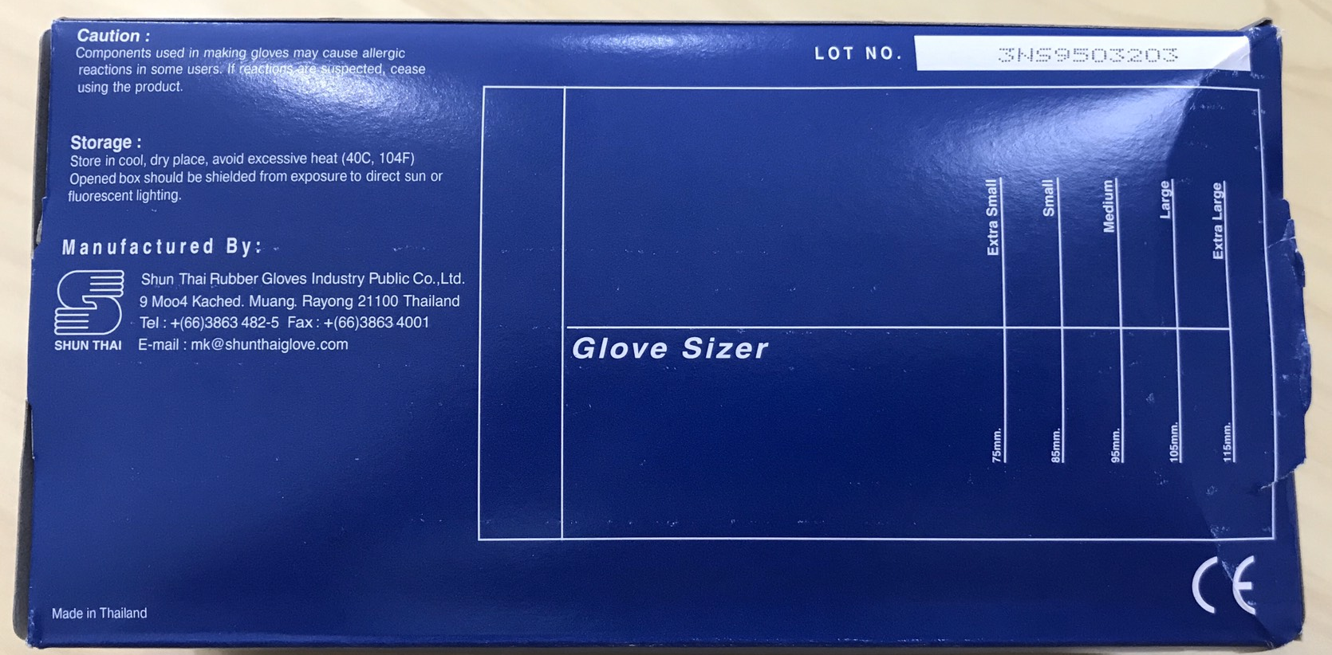
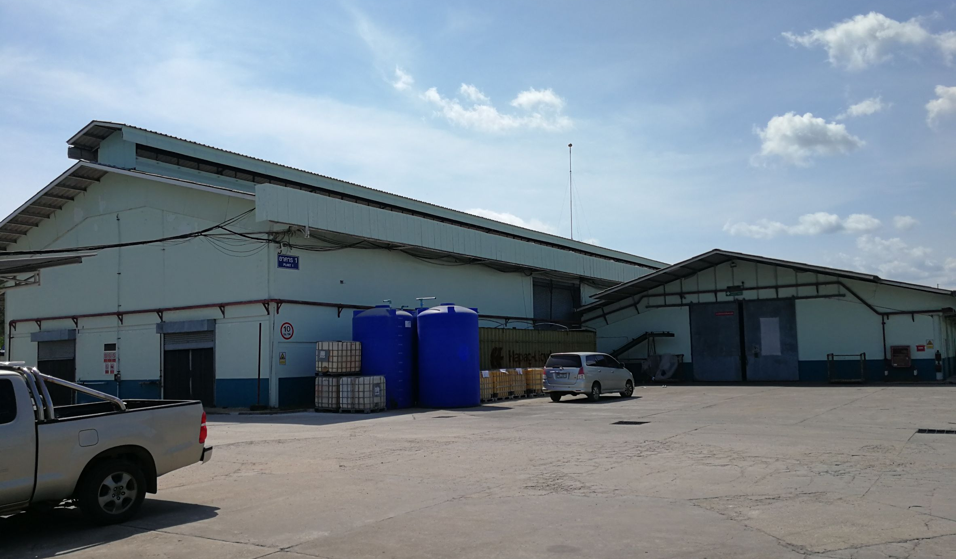

Slide 6
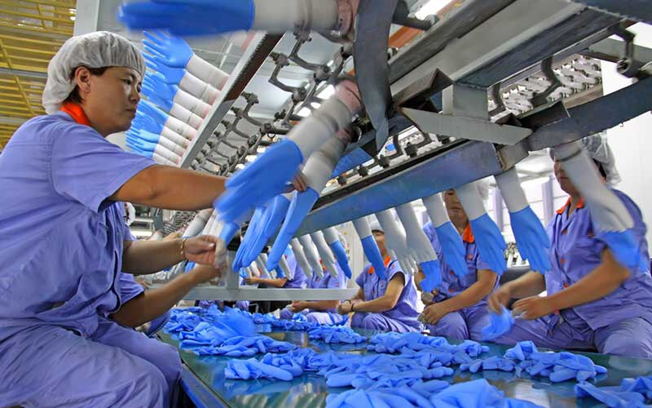
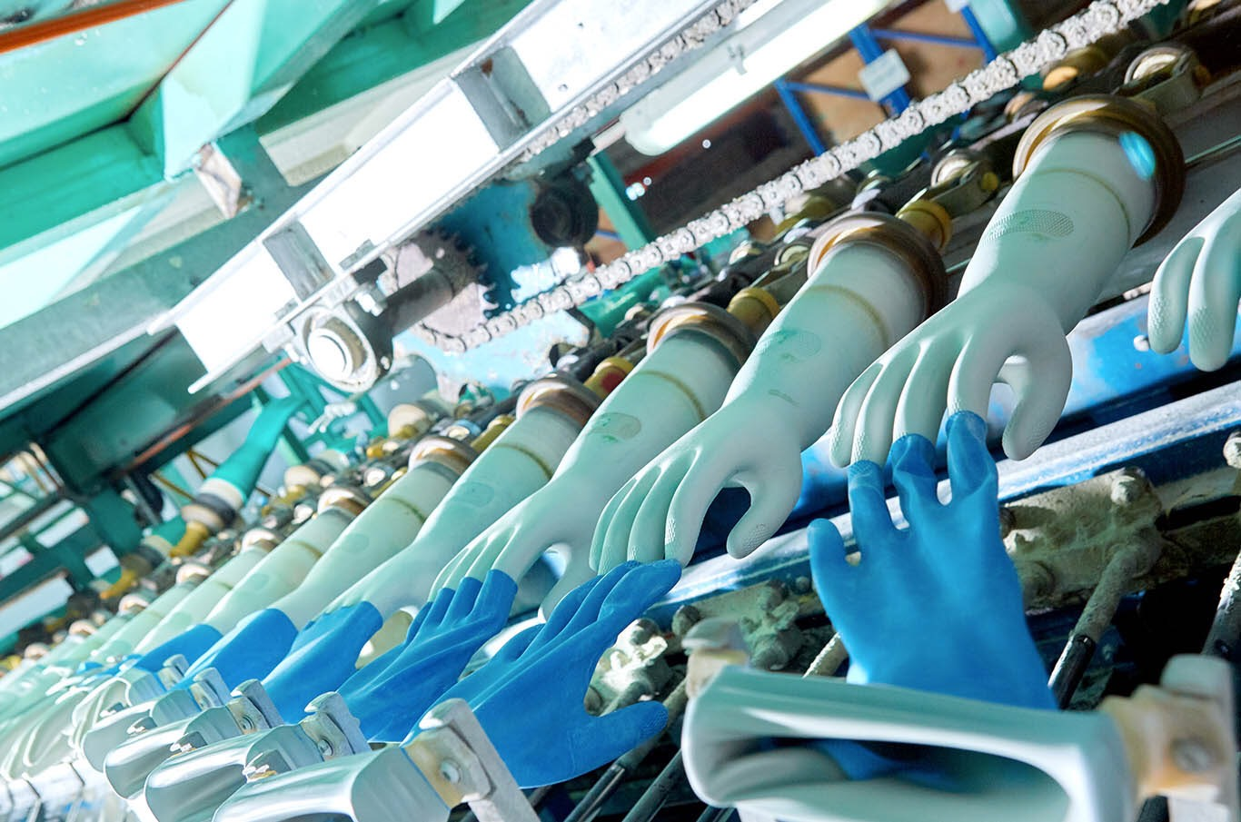
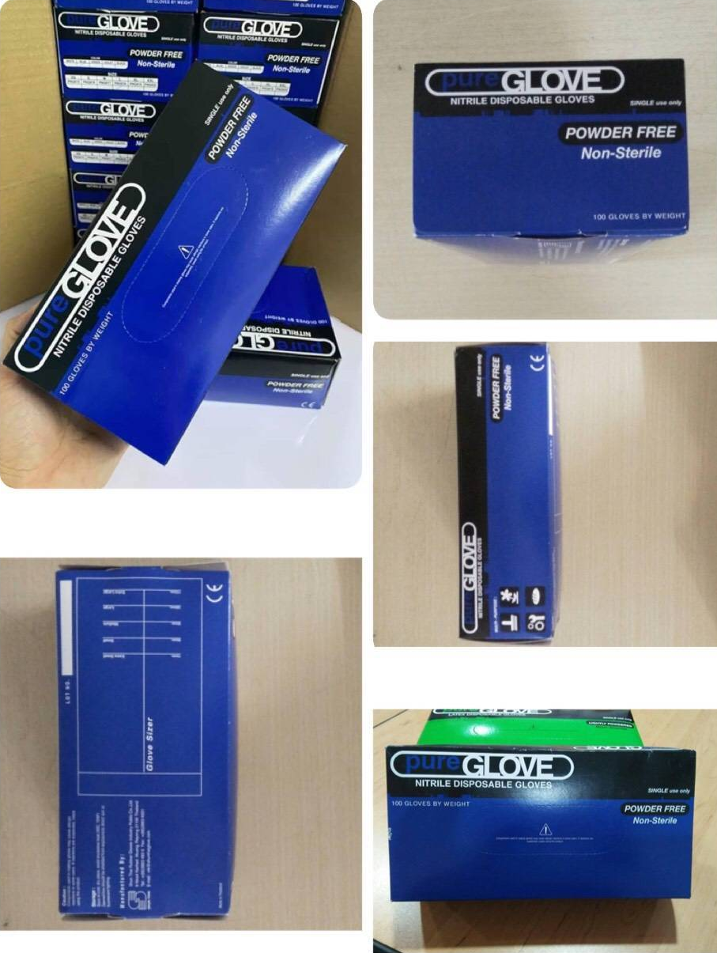
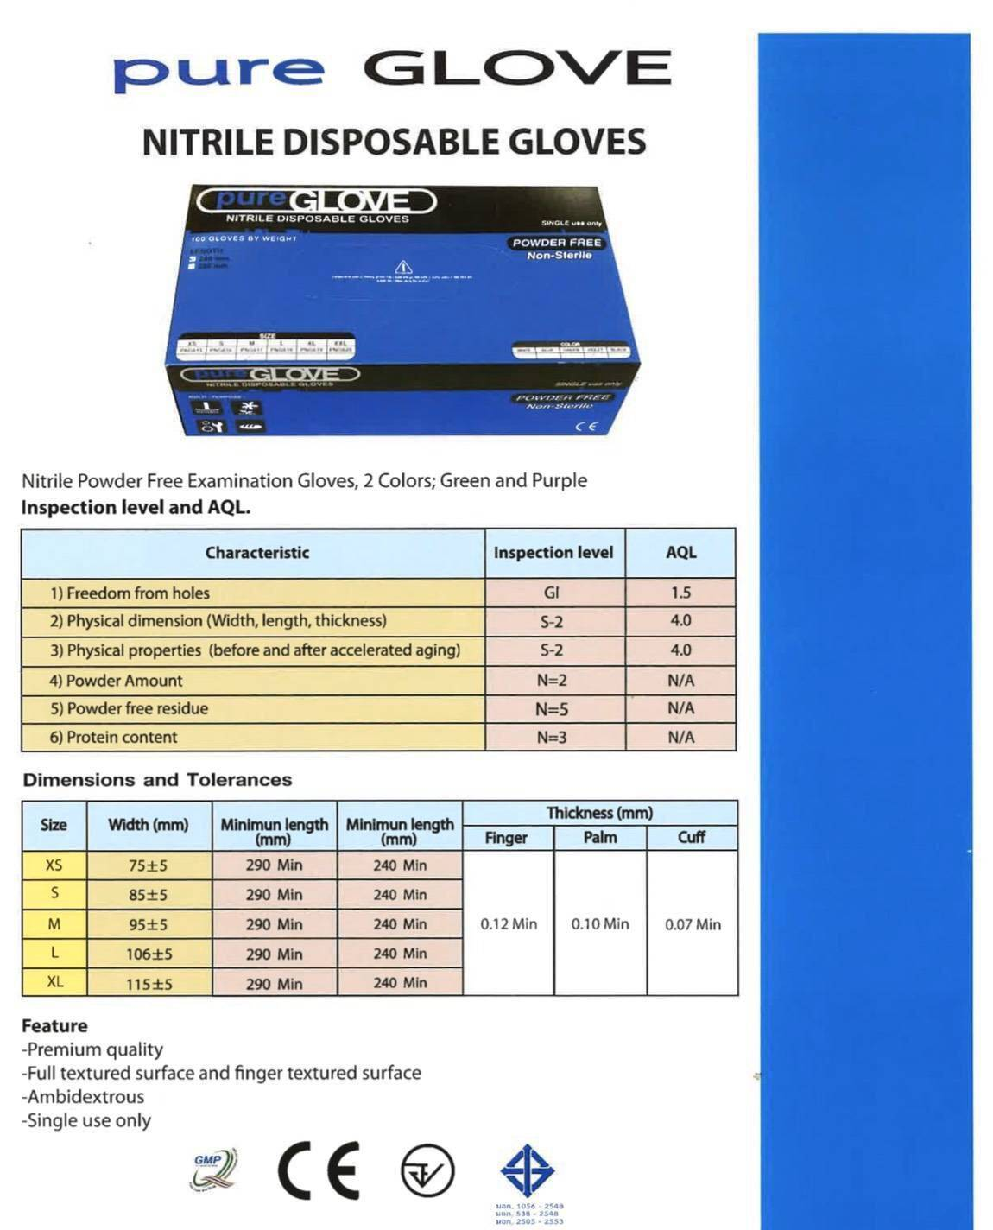
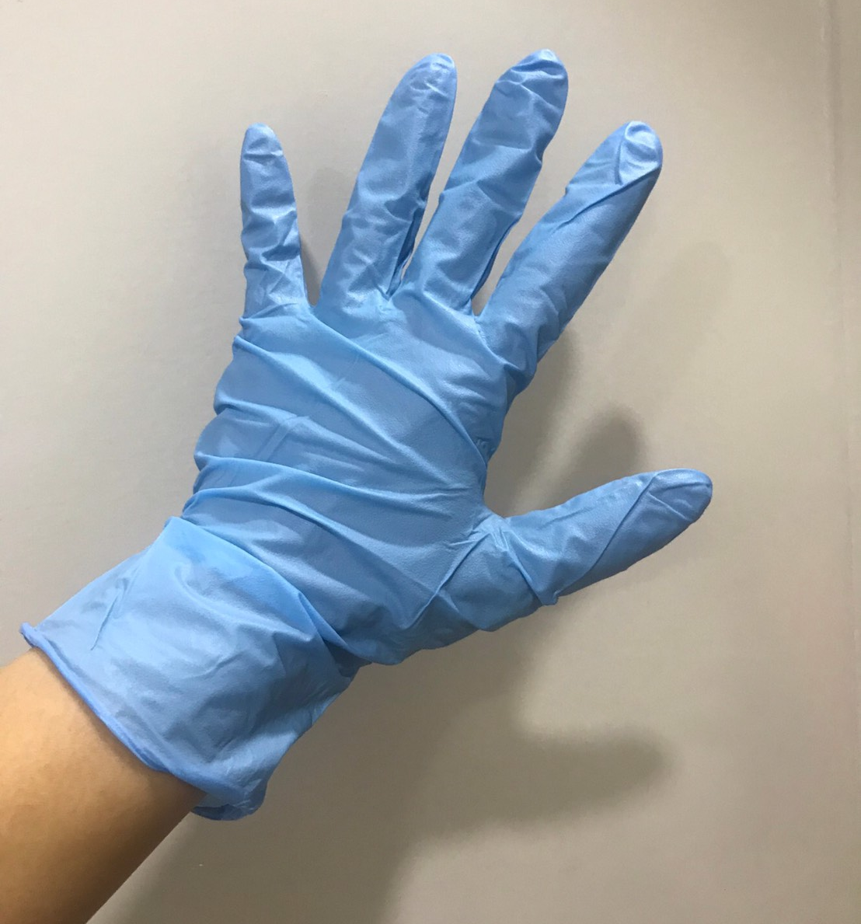
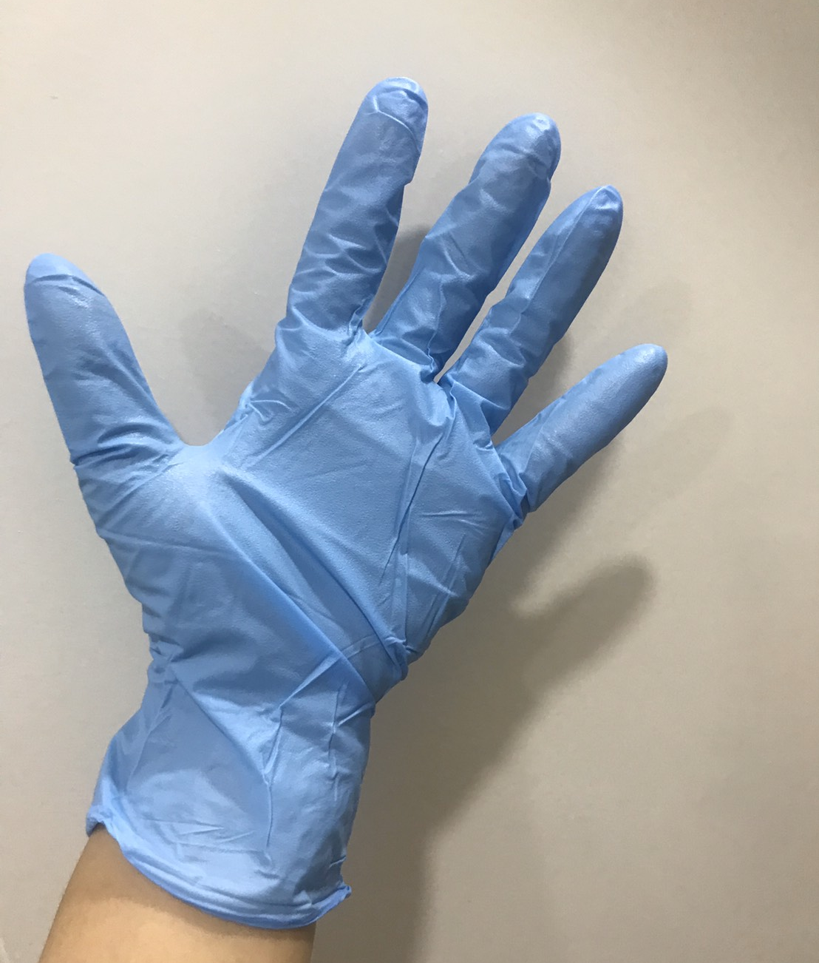

Slide 7
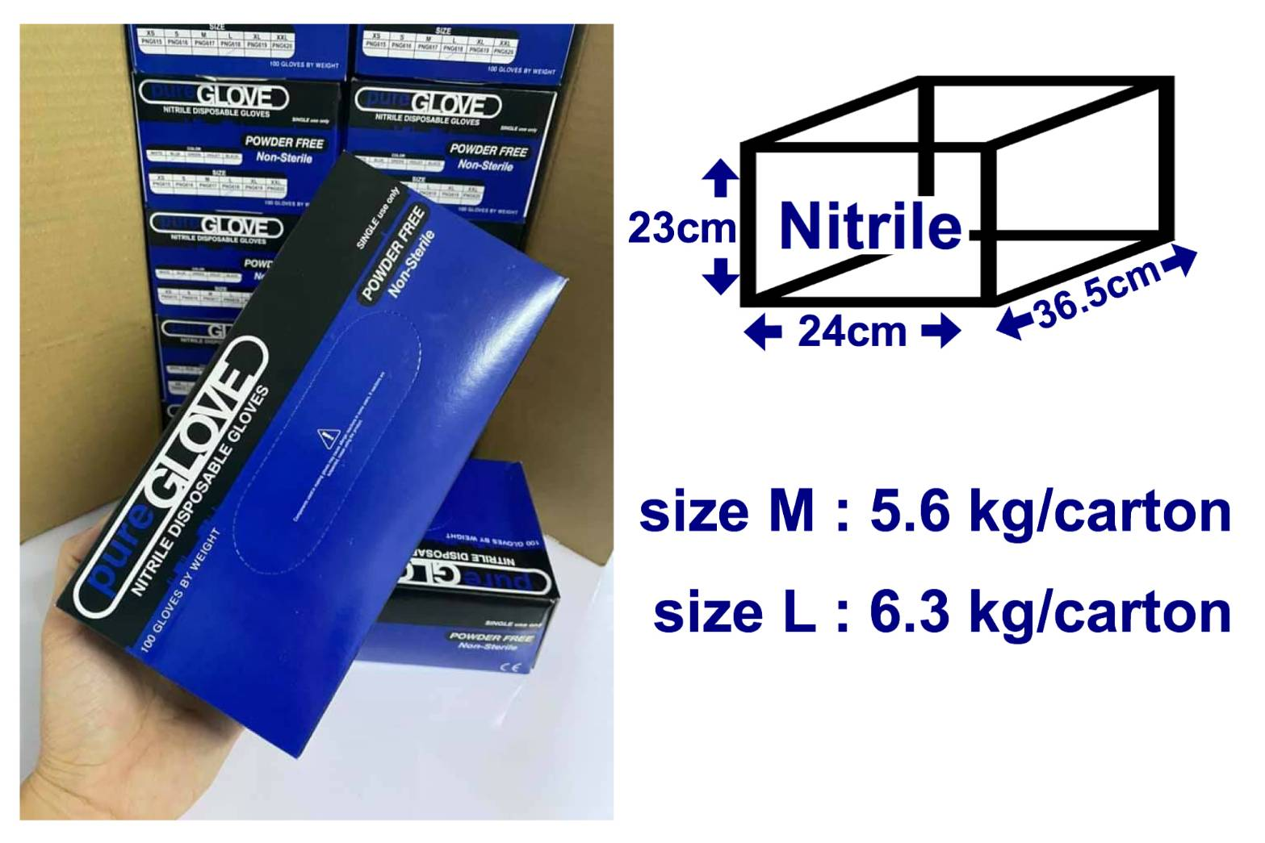
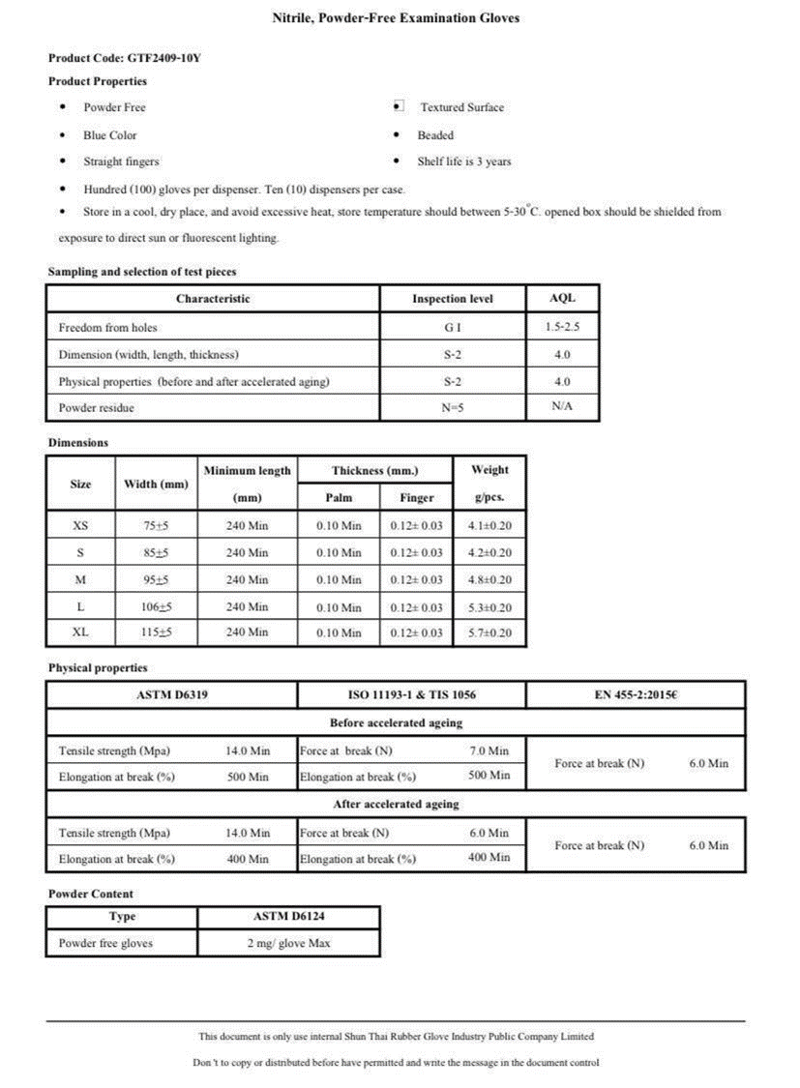

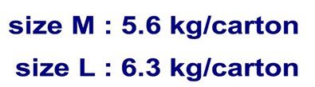
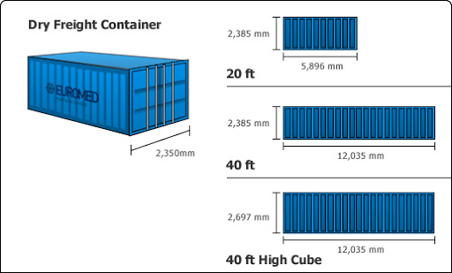
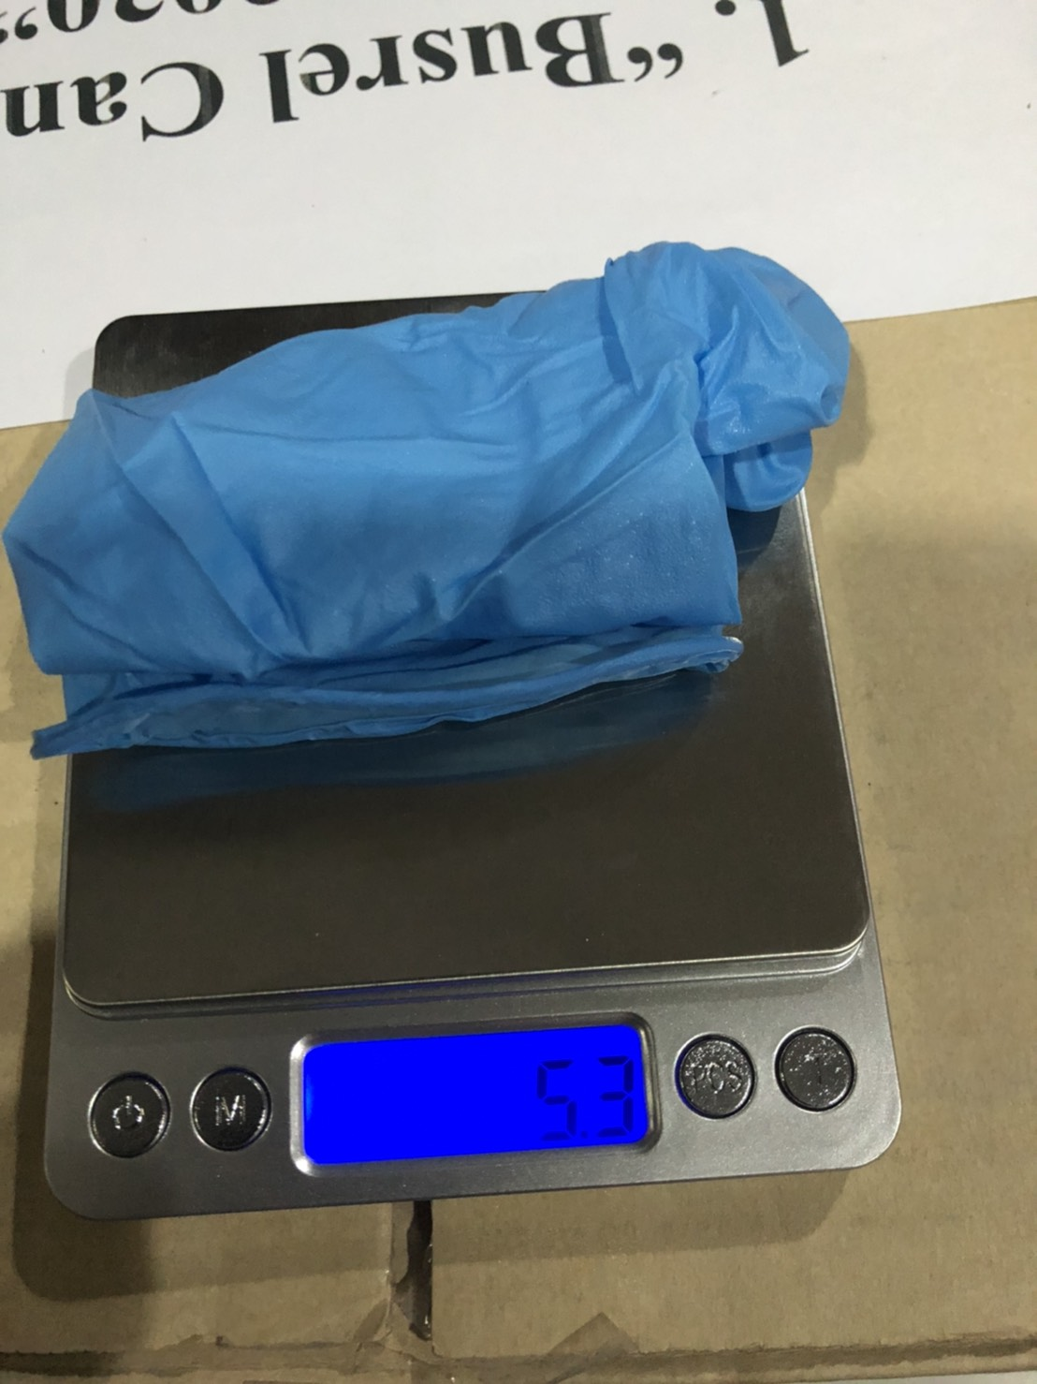
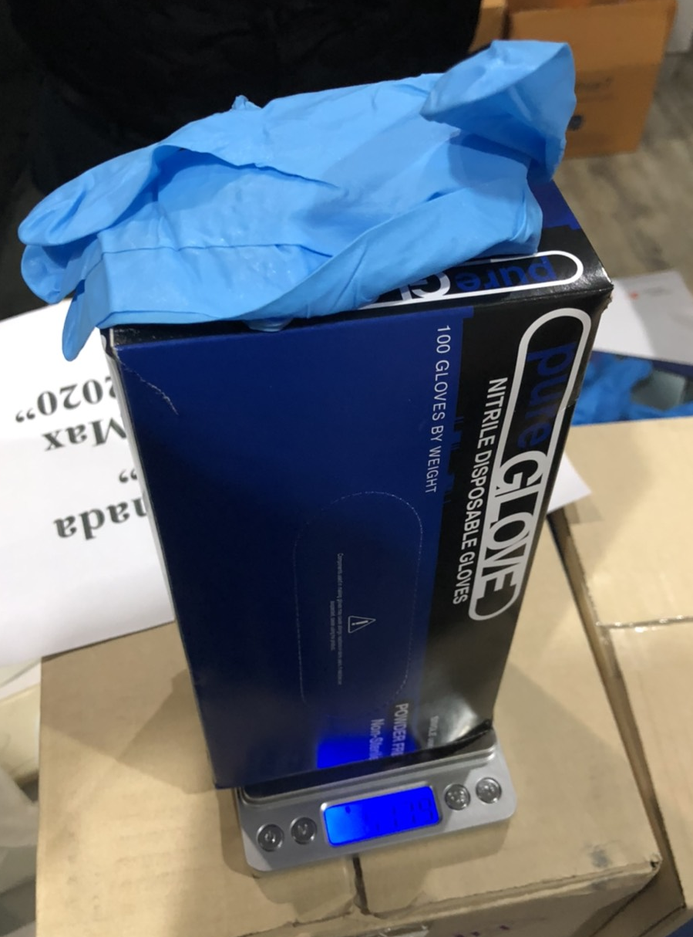
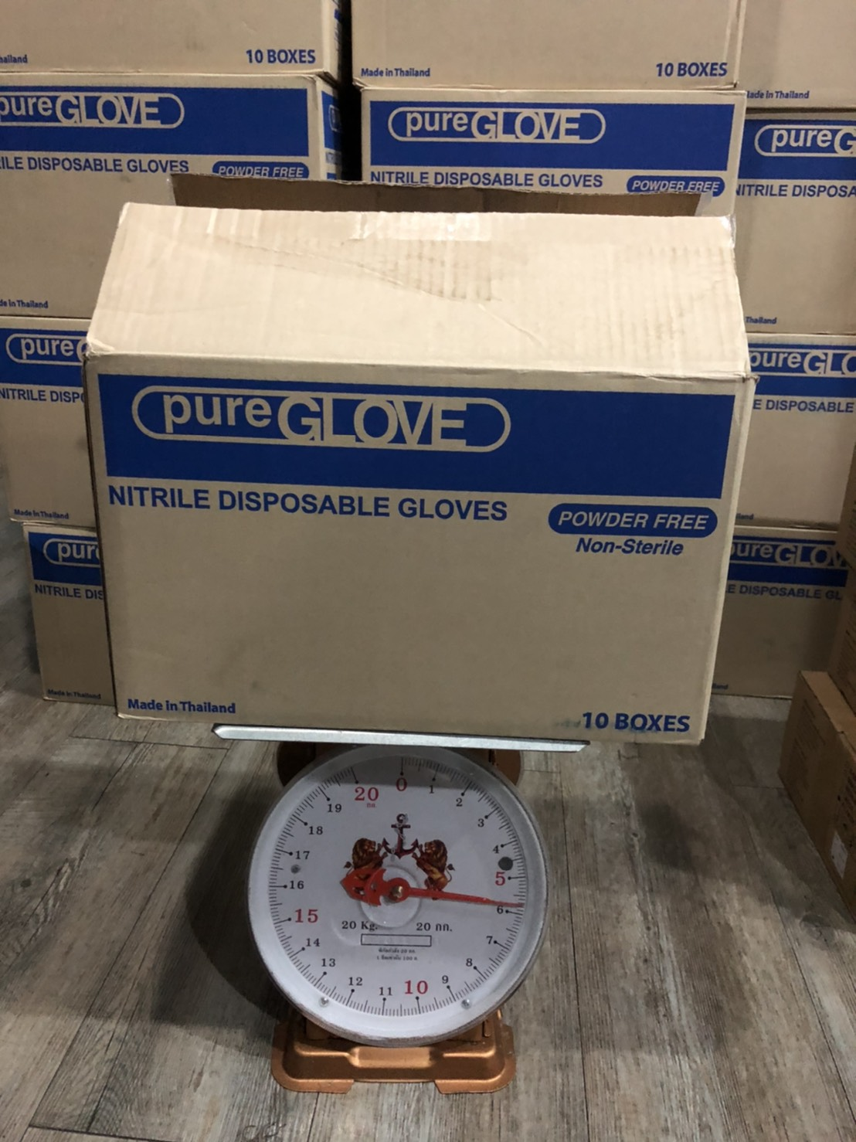
22cm
11cm
7cm
1 box = 100 pcs ~ 537.9g
*1 carton= 10 boxs. = 1,000 Pcs. = 0.02 CBM
1,440 cartons /20'Dc
2,970 cartons /40'Dc
3,267 cartons​ /40'Hc
*1 pallet (1200x800 mm) = Maximum 60 Cartons
~ Weight (Full Pallet) = 398 Kg.
~ Hight = 1,380 mm.
** EST Size L

Slide 8
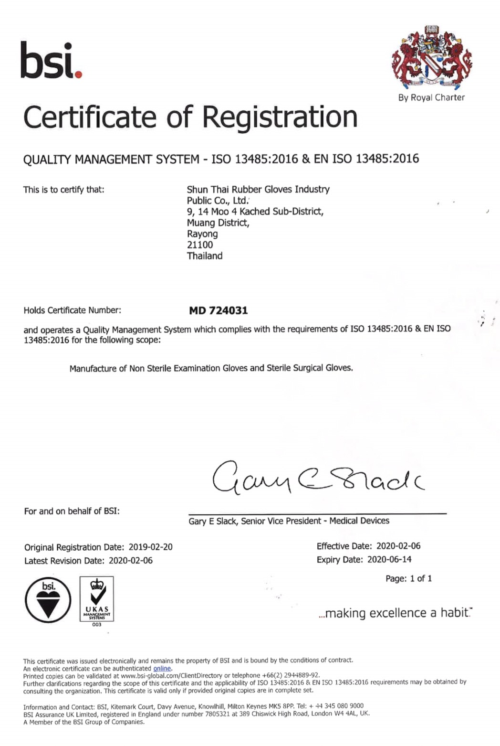
Quality
Management System

Slide 9
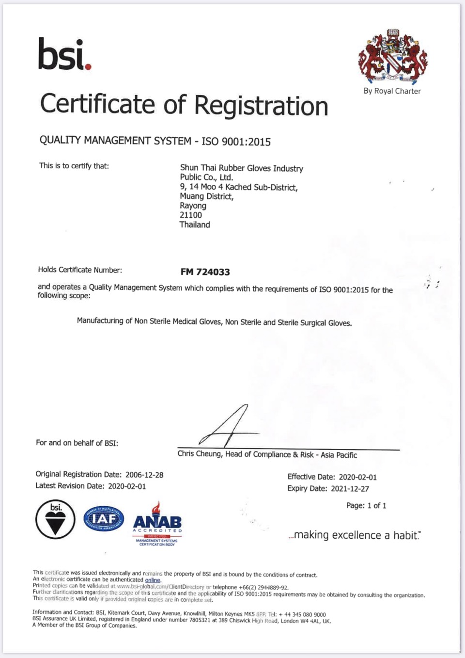
ISO Standard Certificate

Slide 10
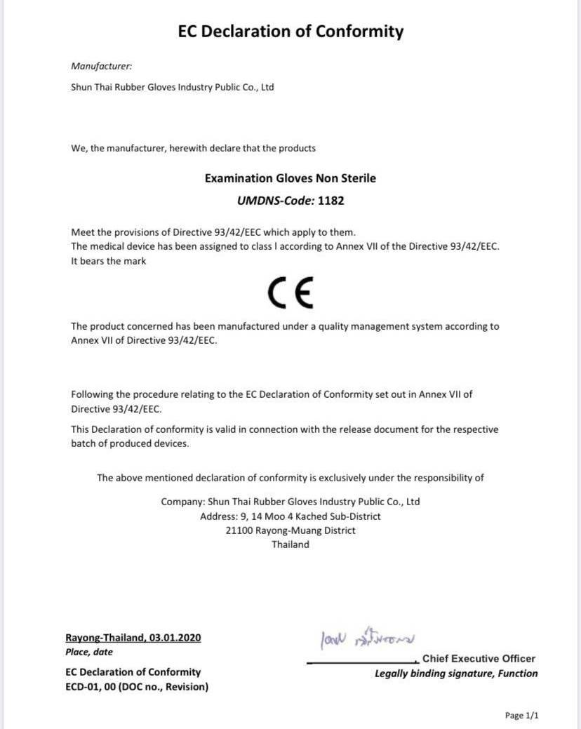
EC Certification

Slide 11
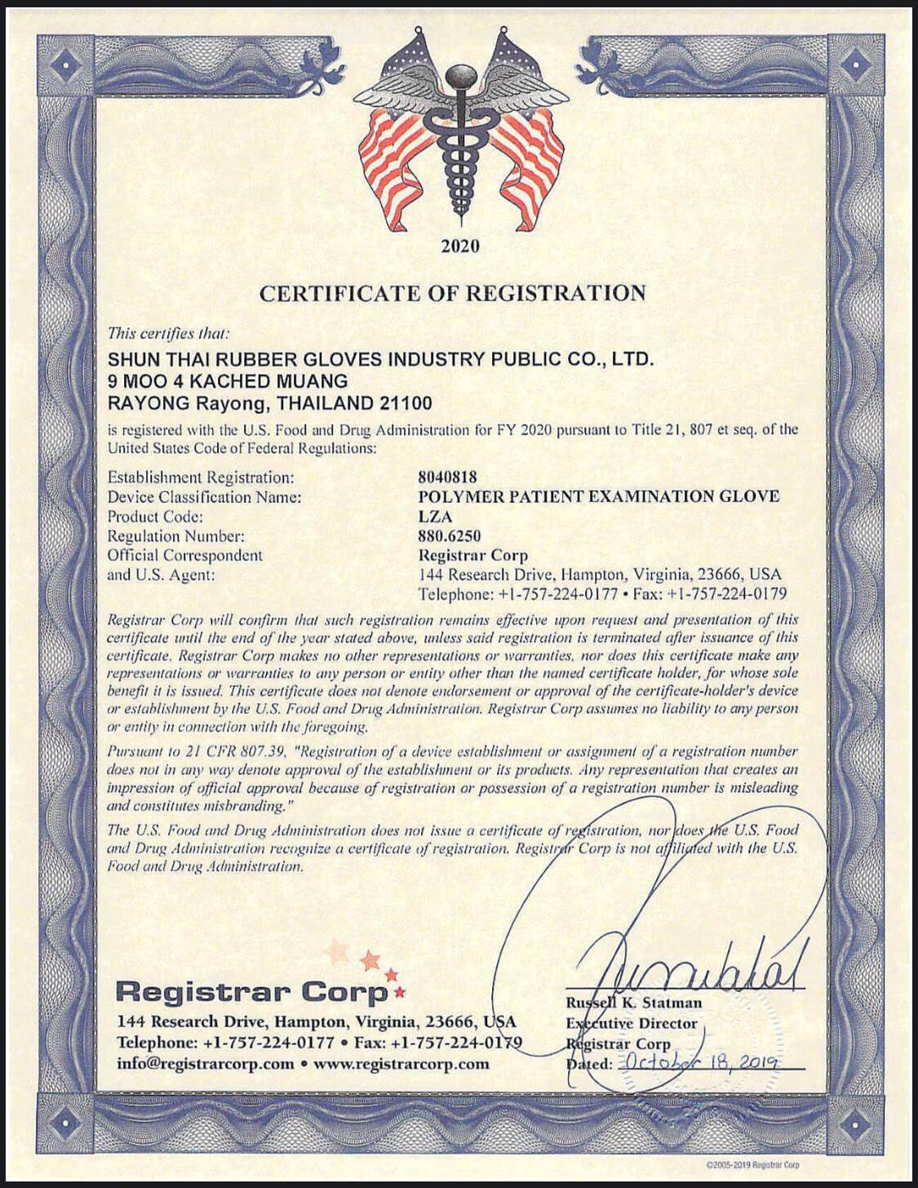
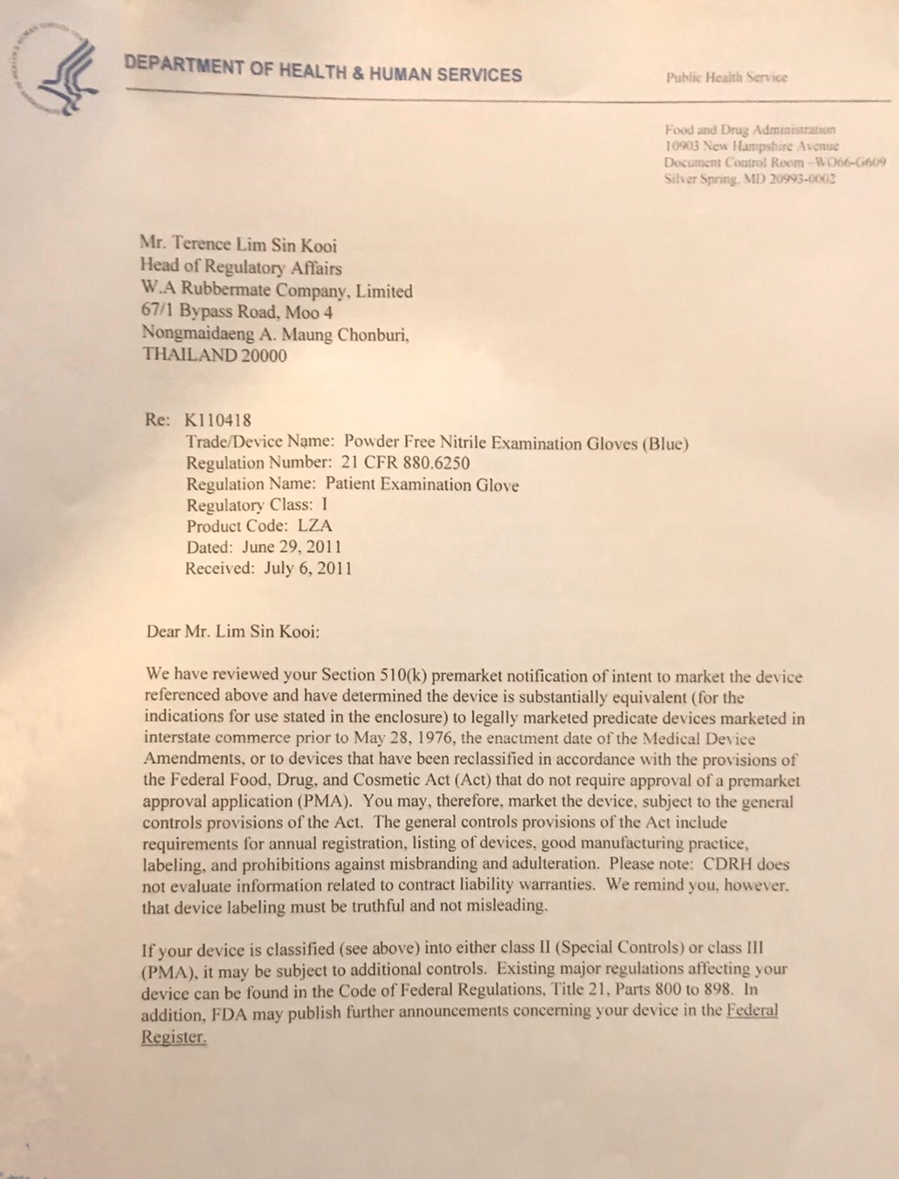
FDA

Slide 12
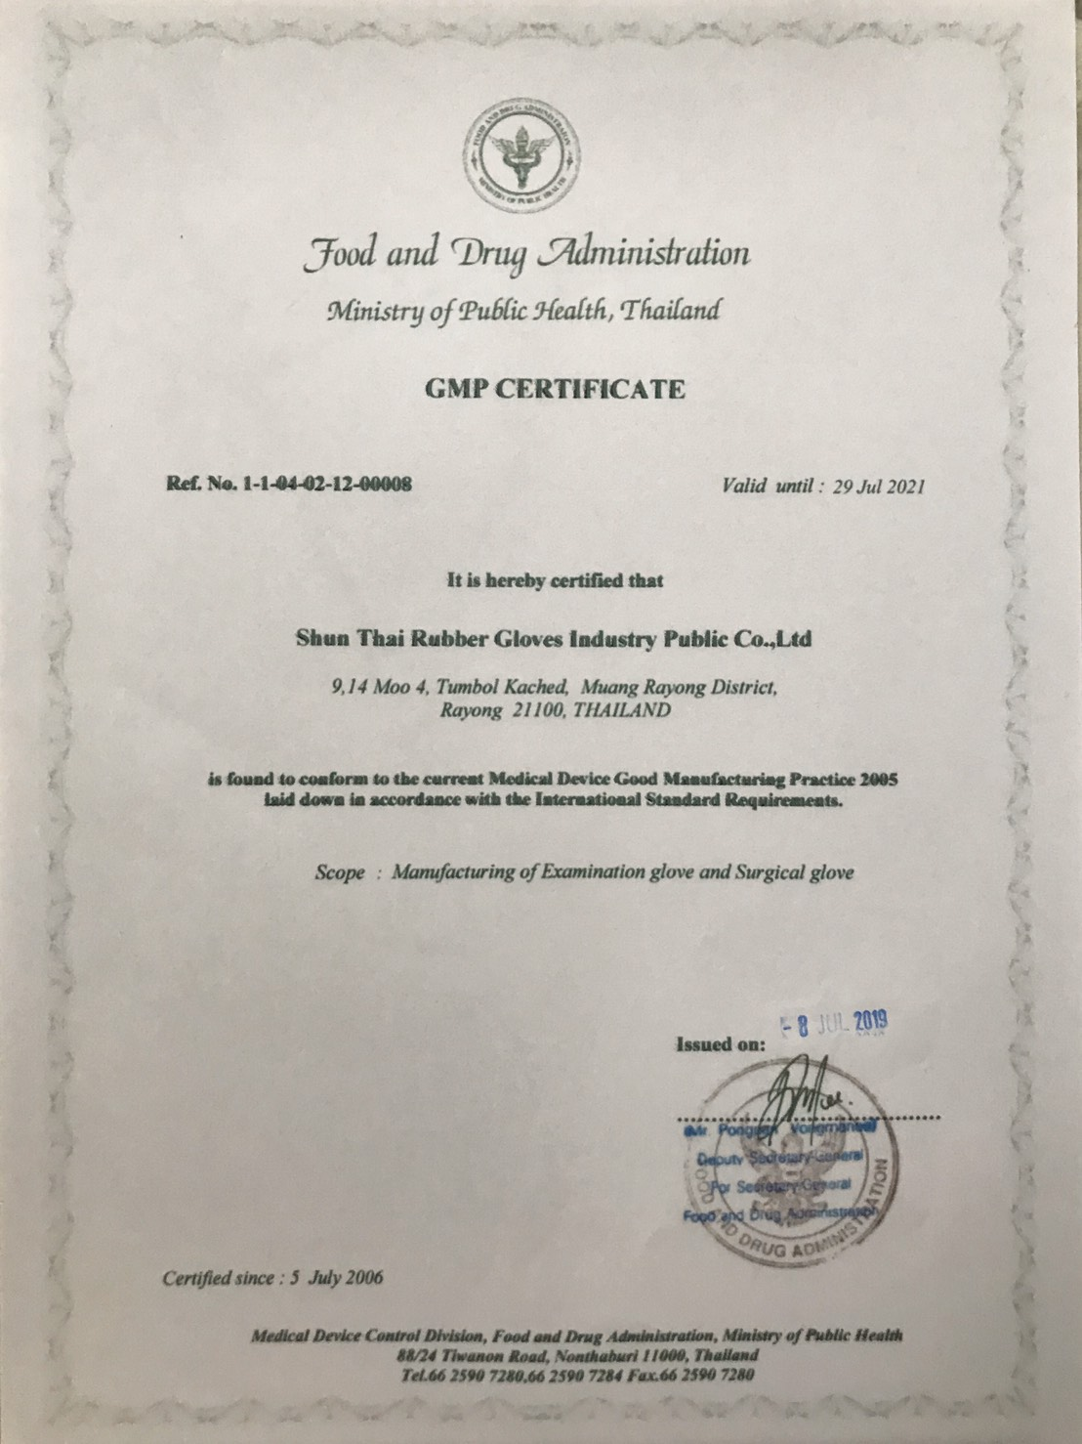
THAI FDA

Slide 13
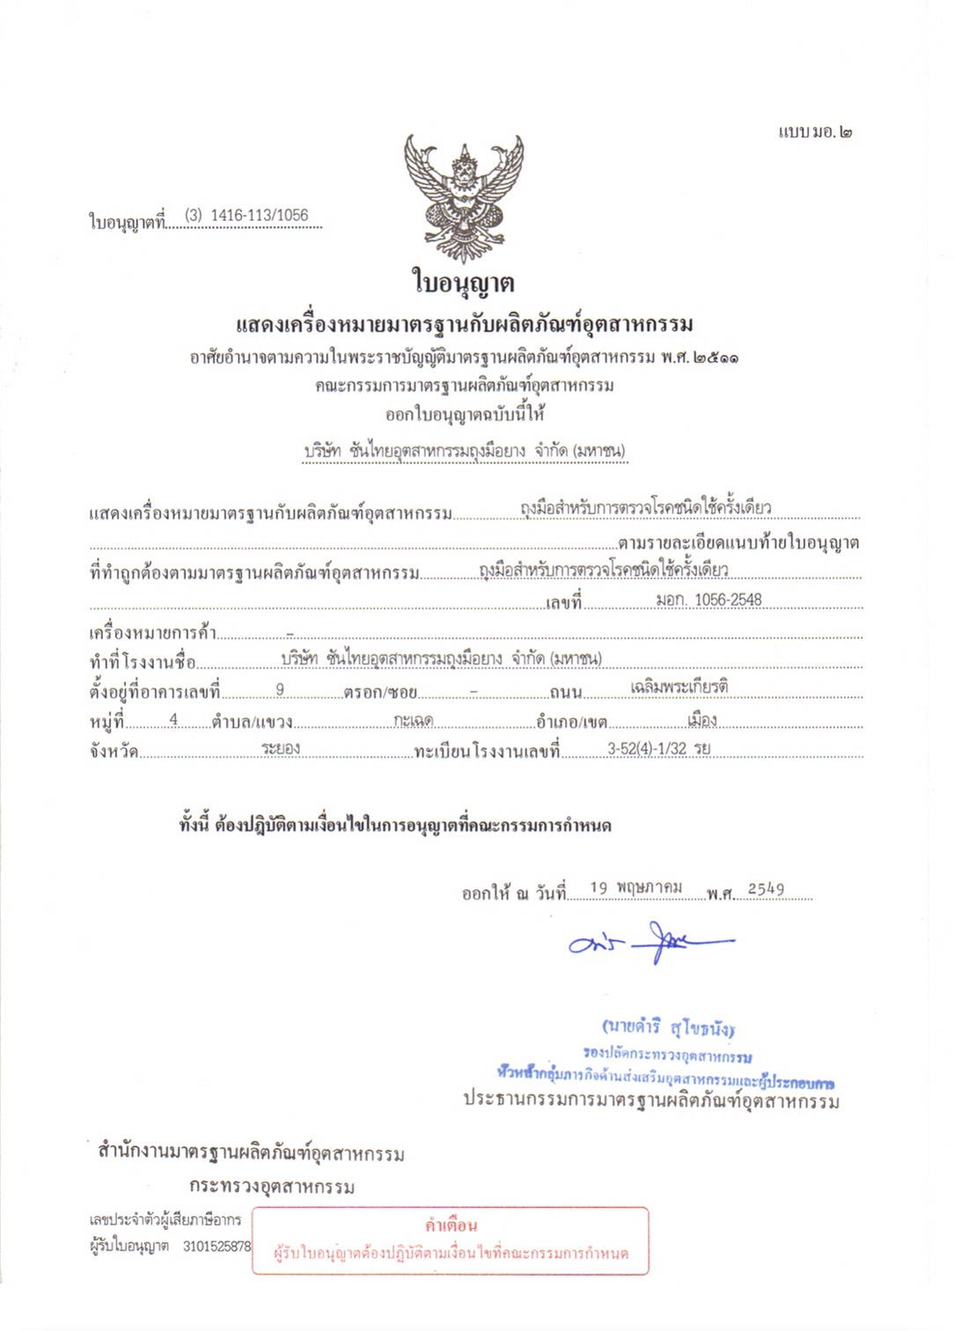
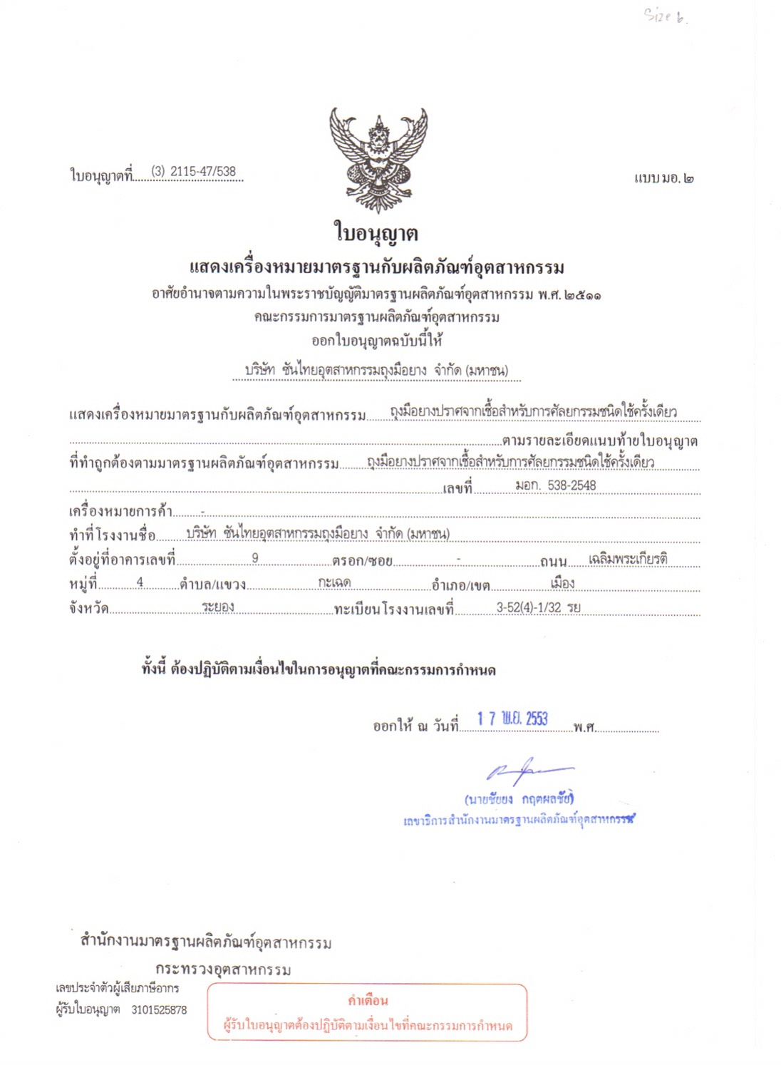

Slide 14
THANK YOU

